Slide 1

EasyReg
Checkpoint 3
Universidade de Aveiro - DETI - May 2025
1

Slide 2
Table of Contents
01
02
03
04
Currently working on
Next Steps
Demo
Calendar
2

Slide 3
Currently Working on (FrontEnd)
  Connections between API and FrontEnd
  CRUD methods for evidence and reviews
  Internal logic with associating:
        Policies -> Projects
        Evidence-> Projects
        Evidence -> Control and Subcontrol
        Internal Review -> Evidence
  Internal Auditor Page
4

Slide 4
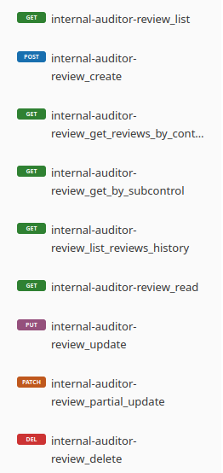
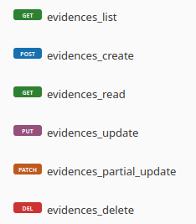
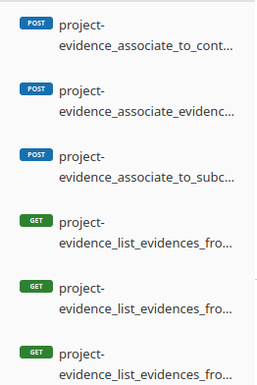
Currently Working on (BackEnd)
Internal auditor endpoints
Project evidence endpoints
Evidence association endpoints
5

Slide 5
Next Steps
  Report Generation Page
  External Auditor Page
  Role Specific Screens views
  Tests
      User Tests
      Usability Tests
      Feedback Analysis
  Reports and Documentation
  Technical Report
6

Slide 6
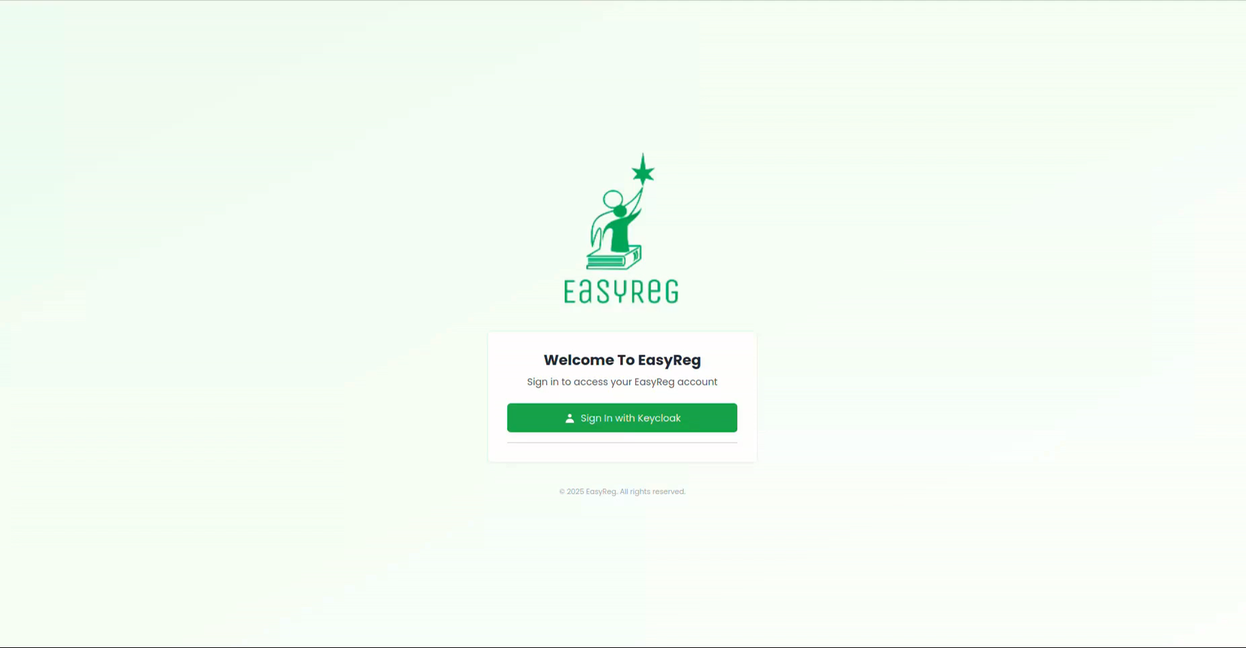
Demo
8

Slide 7
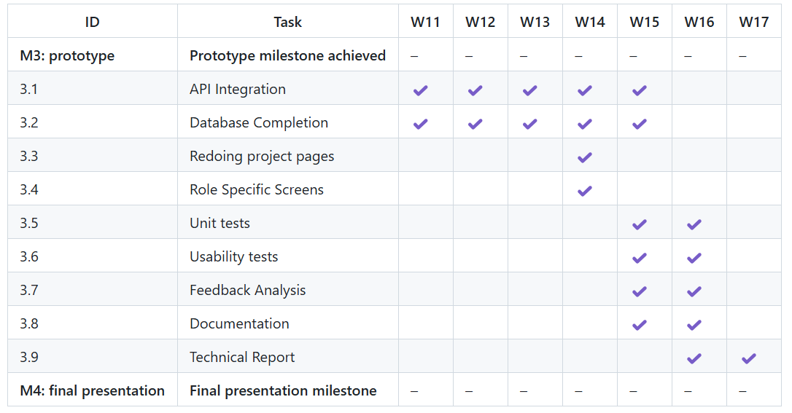
Calendar
7

Slide 8
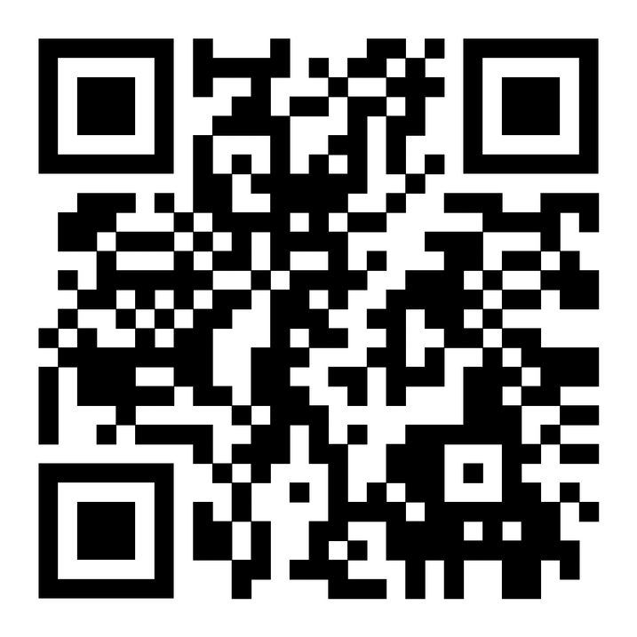
Micro-Site
Thank you!
8

